Slide 1
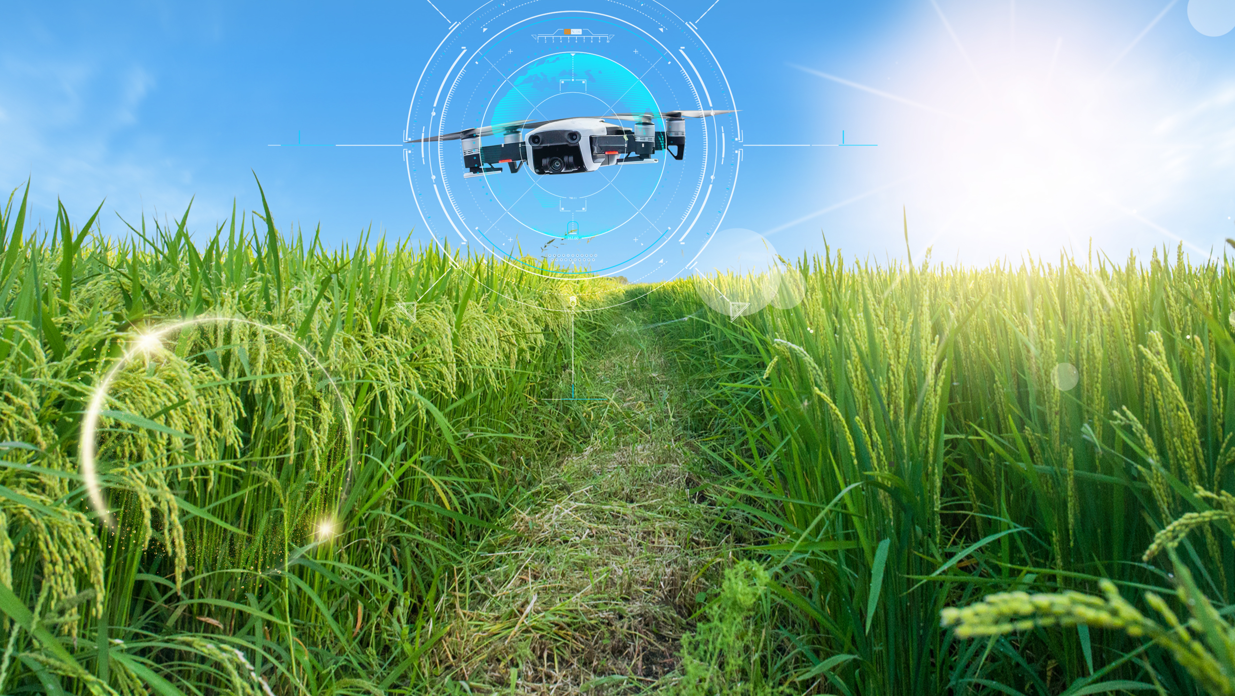
Agriculture- Drone (SecureDrone coin)
Team members
Saurav Sarkar
Kishore Nagarajan

Slide 2
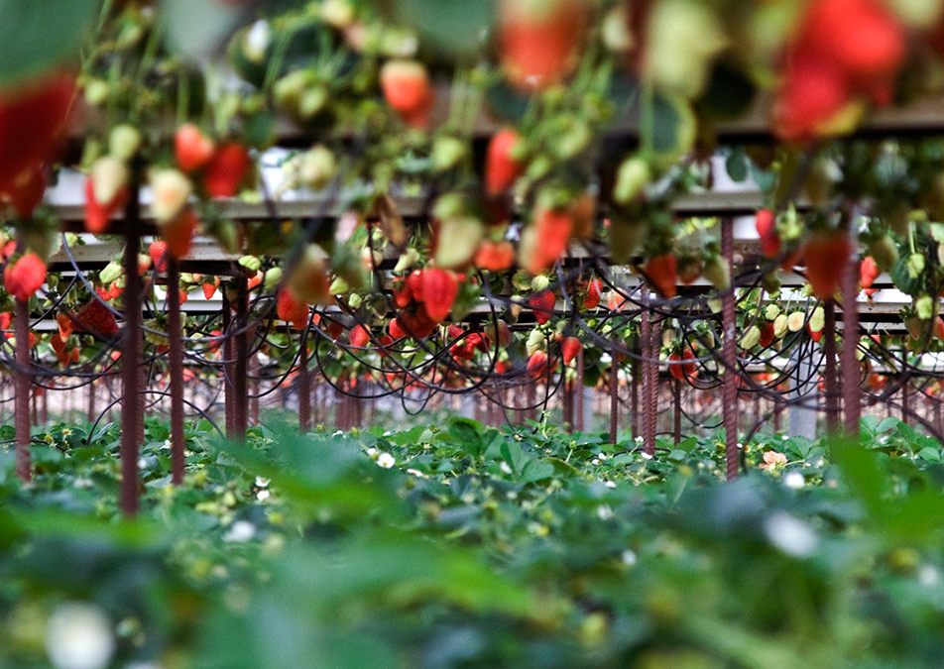
Introduction
Agriculture is the most important sector in India for food security, nutritional security, sustainable development, and poverty alleviation and so on.
The United Nations Food and Agriculture The main challenge of global agriculture is providing a food to the growing population, which is predicted to increase from seven billion people today to approximately nine billion around the year 2050.
Organization (UN FAO) expects that food production must be raised by 70% throughout the following 40 years to meet increasing demand due to rising economic welfare and population growth
The main challenge of global agriculture is providing a food to the growing population, which is predicted to increase from seven billion people today to approximately nine billion around the year 2050.

Slide 3
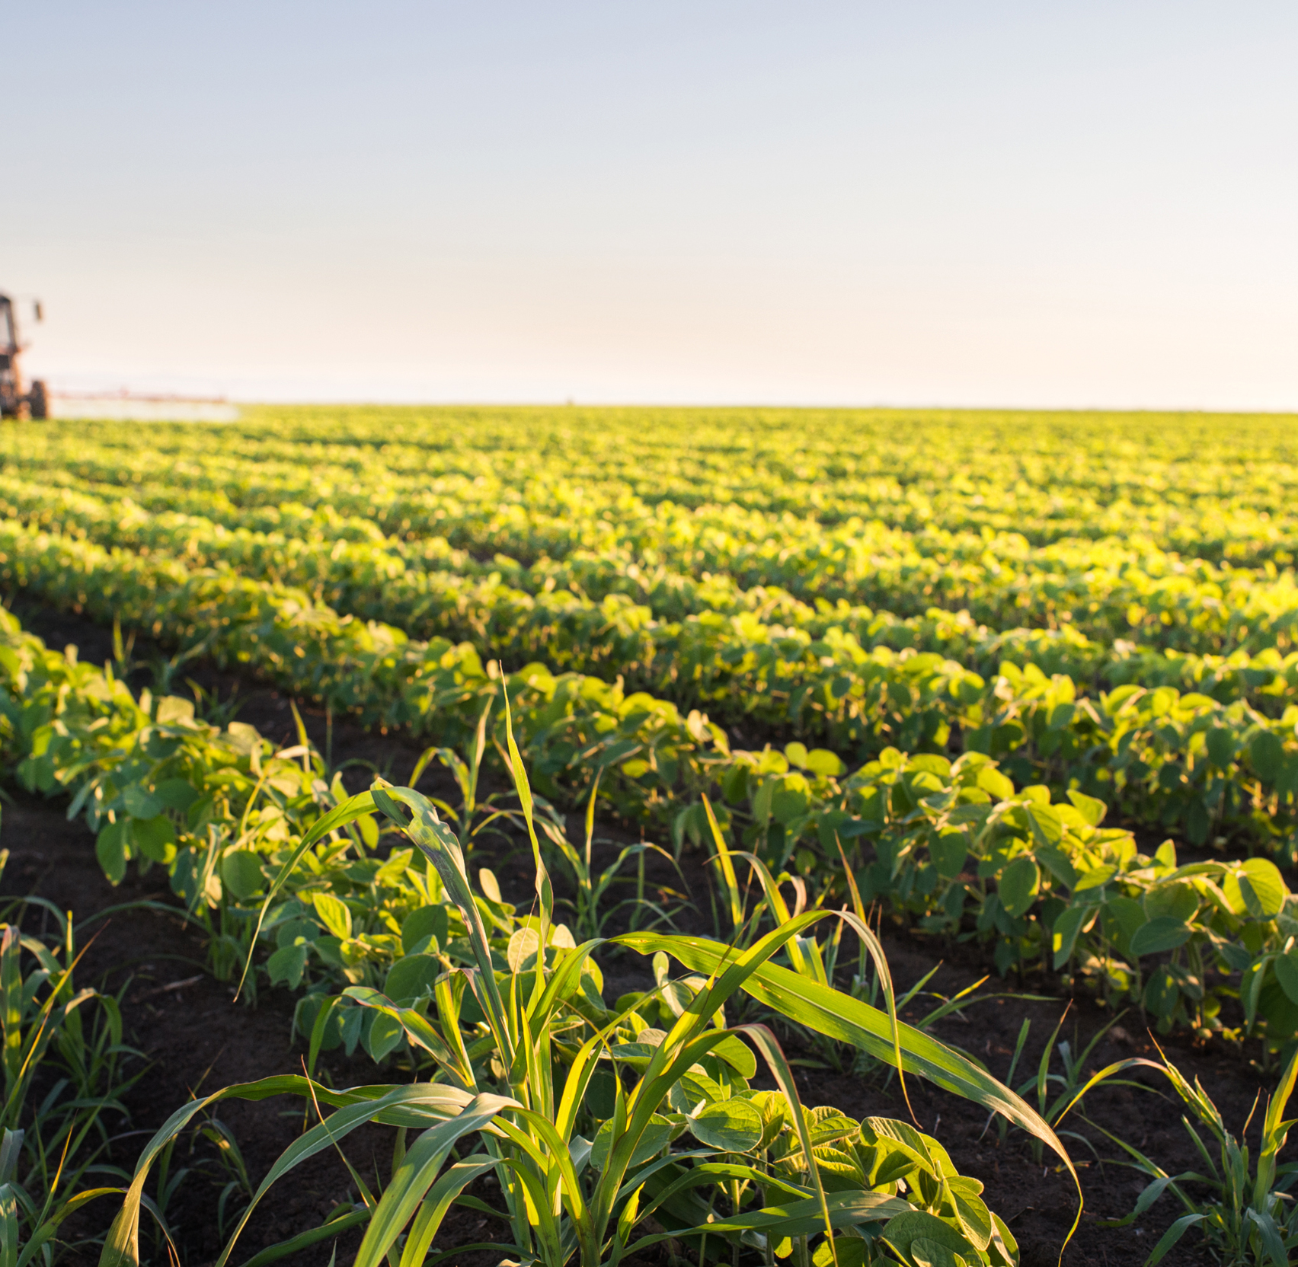
FARMING FOR THE FUTURE

Slide 4
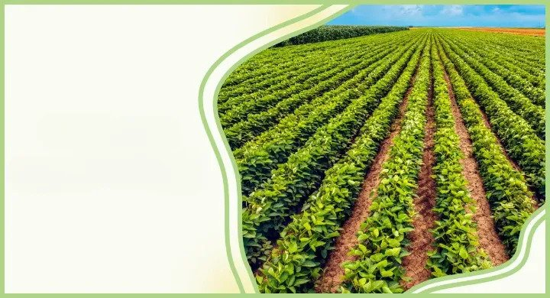
Current Problem with the Modern Agriculture
It takes time and manpower to do all these manual process
Spraying of fertilizers and manure can be inaccurate which means there can be over spraying of these chemicals which can
damage both the crops and the food quality that can also affect the consumers.
Weather prediction can't be done more accurately because of the data manually collected by the farmer can be inaccurate or not enough for predicting the weather.
Killing of insects and plucking weeds can't be done more efficiently in manual process since manual action tends to do more mistakes.
These are some of the problems that can ultimately destroy the productivity and the efficiency of the crops and can affect the food quality very badly leading to some health problems to the consumers who consumes it.

Slide 5
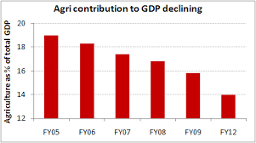
CURRENT PROBLEM WITH THE AGRICULTURE
But as each generation passes by, the number of Farmers involved in agricultural practises is declining.
If this continues, agriculture will not be able to meet the increasing demands of the world,, which may lead to starvation and modern civilization might decline.
because of the fewer participants, Data collected for agriculture practises might be inaccurate, and sometimes we will not be able to cover all the data.
So, the prediction of what is going to happen next will be uncertain.

Slide 6
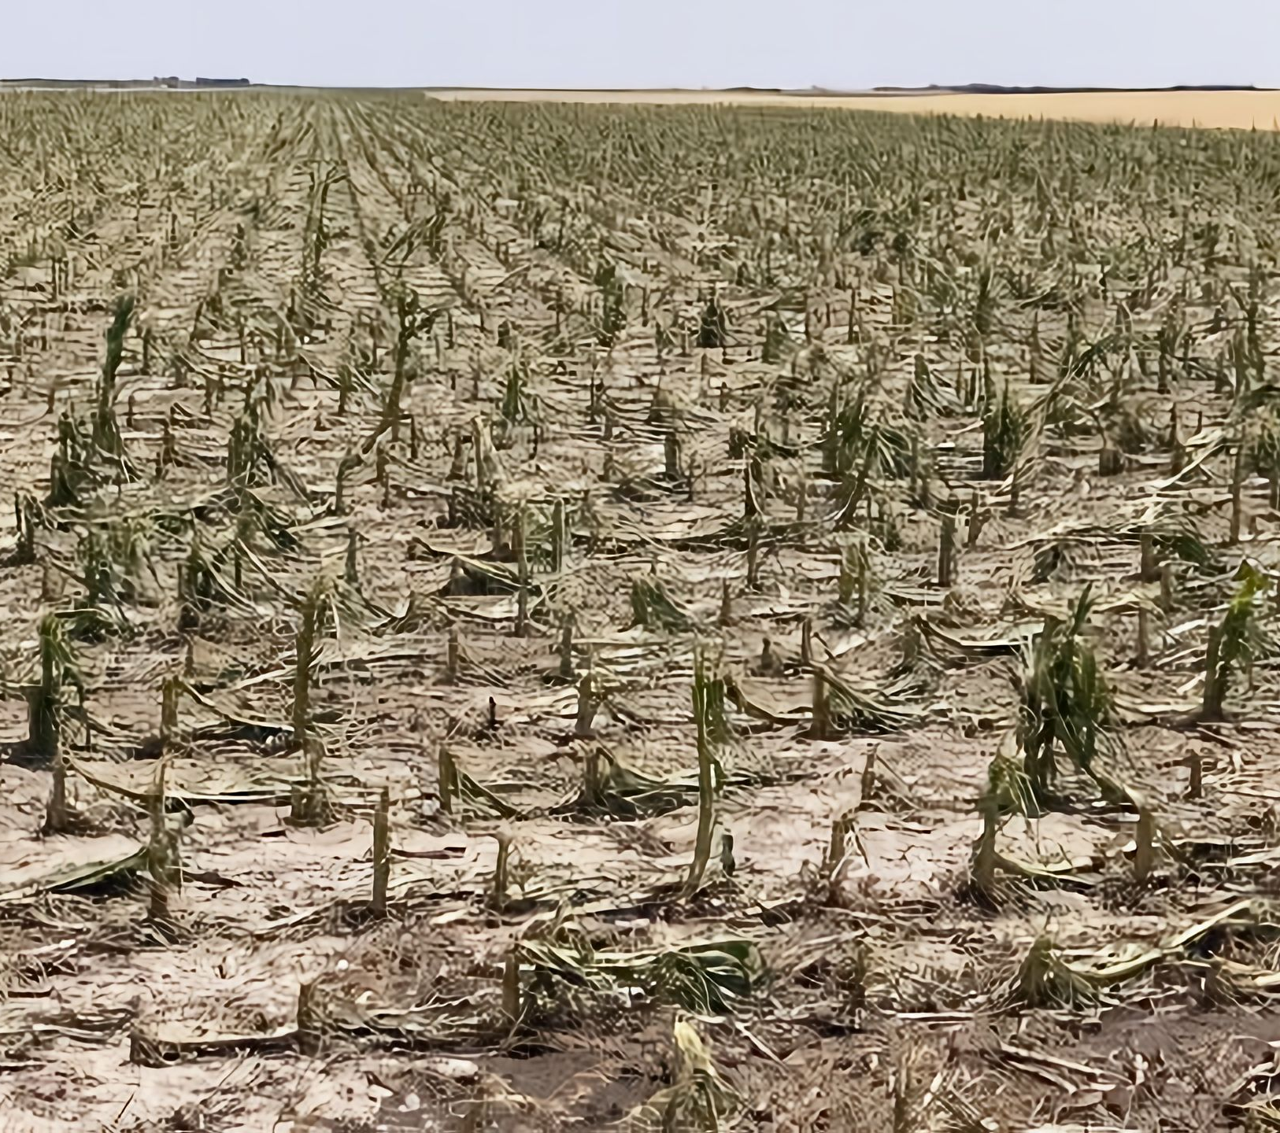
WORST CASE SCENARIO
Have you ever thought about a world without agriculture?

Slide 7
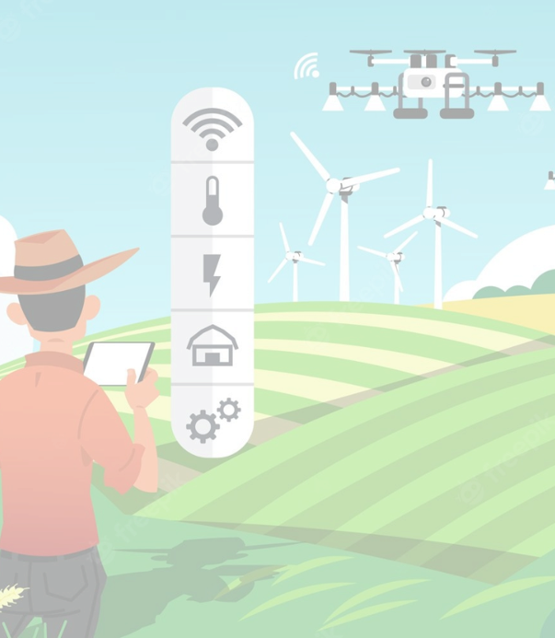
Solution: Agriculture-Drone
Soil and Field Analysis: Agricultural drones can be used for soil and field analysis for field planning and also uses sensors to measure soil erosion, soil conditions, soil nutrients, soil fertility etc.
Crop Monitoring: Monitoring crops from seeding to harvesting, Tracking the impact of weather conditions and inspecting for insect infestation can be done with the help of blockchain and also it will help with seasonal crops. Crop surveillance helps in understanding and planning for the next farming season.
Plantation: Drones can be used for planting crops instead of using human help.
Crop Spraying: These drones can also spray chemicals because they have reservoirs that can be filled with fertilizer and insecticides for spraying on crops in time.
Check Crop Health: Constant survey are required to track the soil health and the crop that has been planted. It can be done by human for days but with the help of drone, it can be completed in few hours.
Security: The data collected from the drone can be securely stored and monitored. The communication between the drones and the ground station server (GSS) are done more securely.

Slide 8
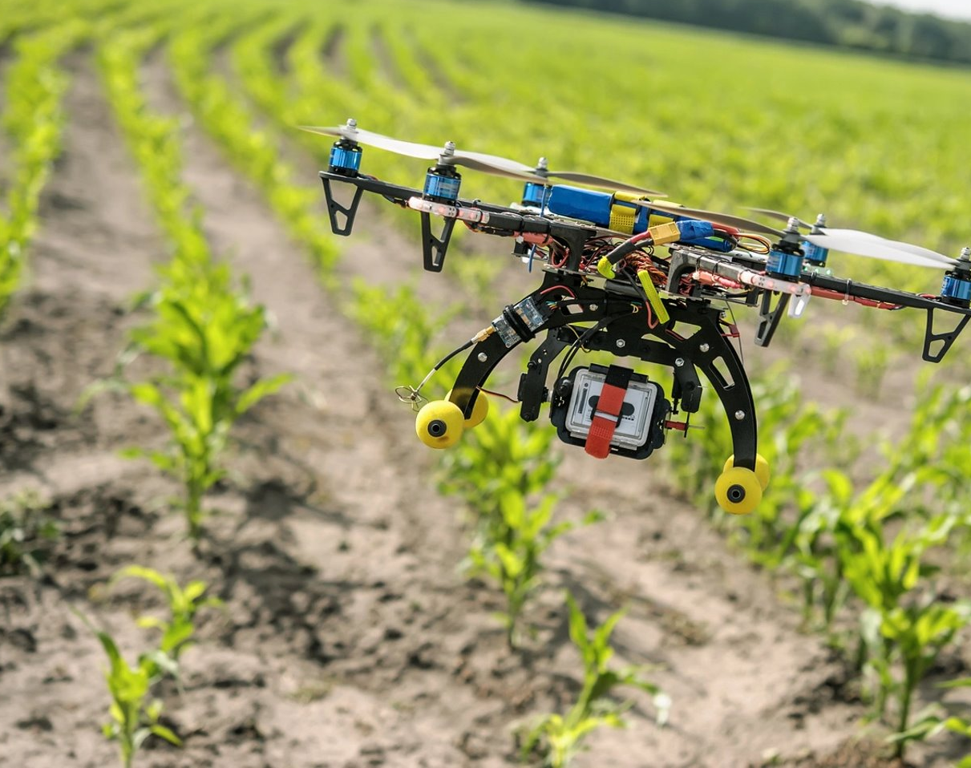
Problems of Drones without Blockchain
There is a danger that the information will be used improperly and that it will be transferred illegally. The Drone can be easily hacked since the communication between the drone and the ground station can be insecure which leads the data to be leaked to the anonymous third party.

Slide 9
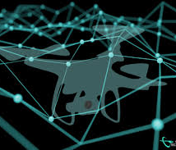
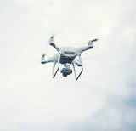
Drone With Blockchain
By introducing Blockchain technology in agriculture. that can provide real-time information about the crop status or livestock movement, so that decision on cultural operations and management is made efficiently and precisely.
Here, the main motive is to provide automation as a service. That is, input data for the condition of the crops, weather data, and data for precise spraying of the pesticides and insecticides are collected and stored in the Blockchain
This not only improves the accuracy of data collection, which is for weather prediction, crop condition, and precise spraying, but can also ultimately improve the productivity and efficiency of food and other agricultural products exported.

Slide 10
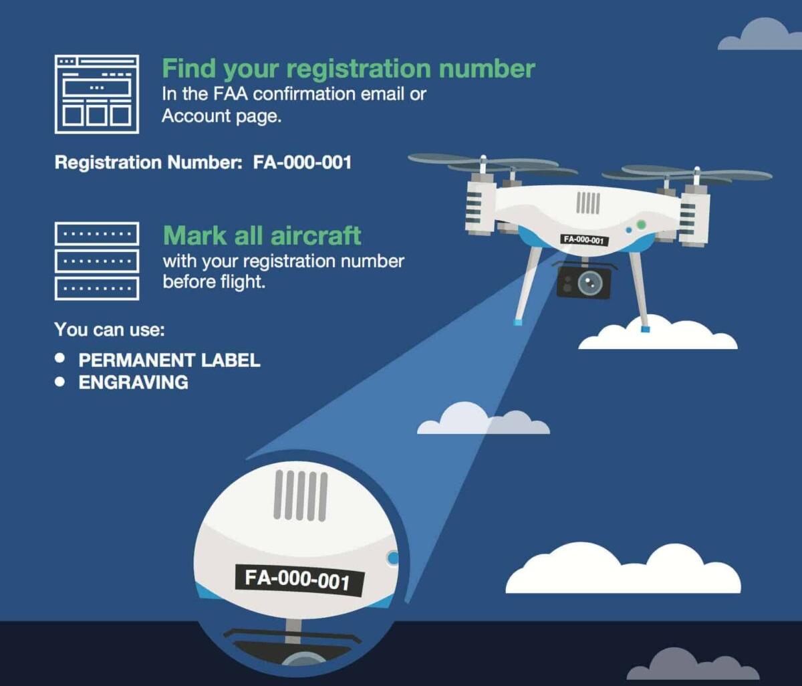
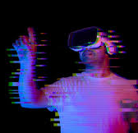
Drone Registration
Users can apply for accounts in the blockchain and locally store the encrypted private key. Users submit their account address to the administrator through a secure channel. After verifying the registration requested by the user, the administrator adds the address to a trusted list in the smart contract. In contrast, for the users who apply for account cancellation or loss, their addresses are added to the revocation list of the smart contract.
Metaverse
Basically, virtual reality and mixed reality worlds are accessed through a browser or headset, which allows people to have real-time interactions and experiences across distances. Here, Metaverse is used as a simulation, which is used to train the pilots on how to use the drones. Thus, after training the pilots through Metaverse simulation, these trained pilots are certified for their completion of their drone training. Only certified pilots are allowed to use the drones and these pilots are registered for the specific drone with a unique ID.

Slide 11
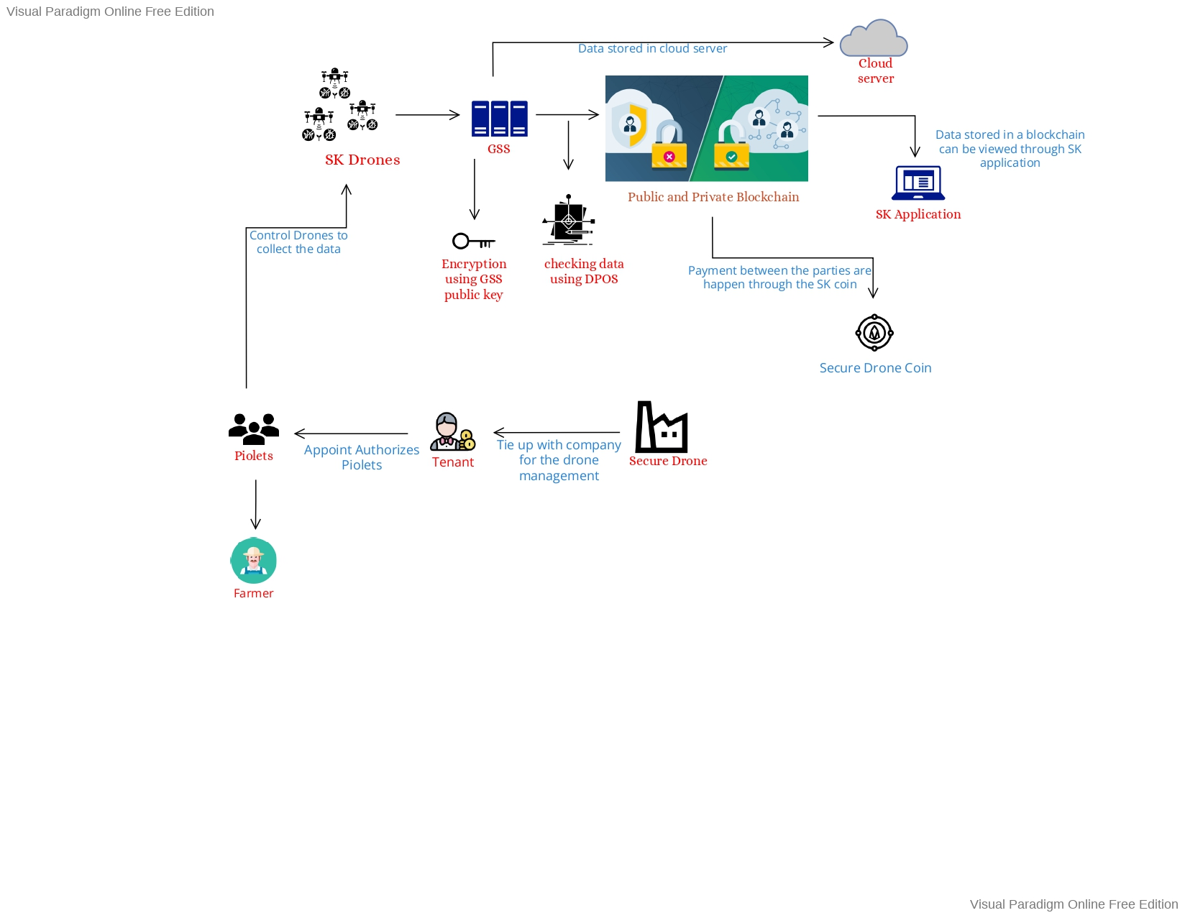
SOLUTION ARCHITECTURE

Slide 12
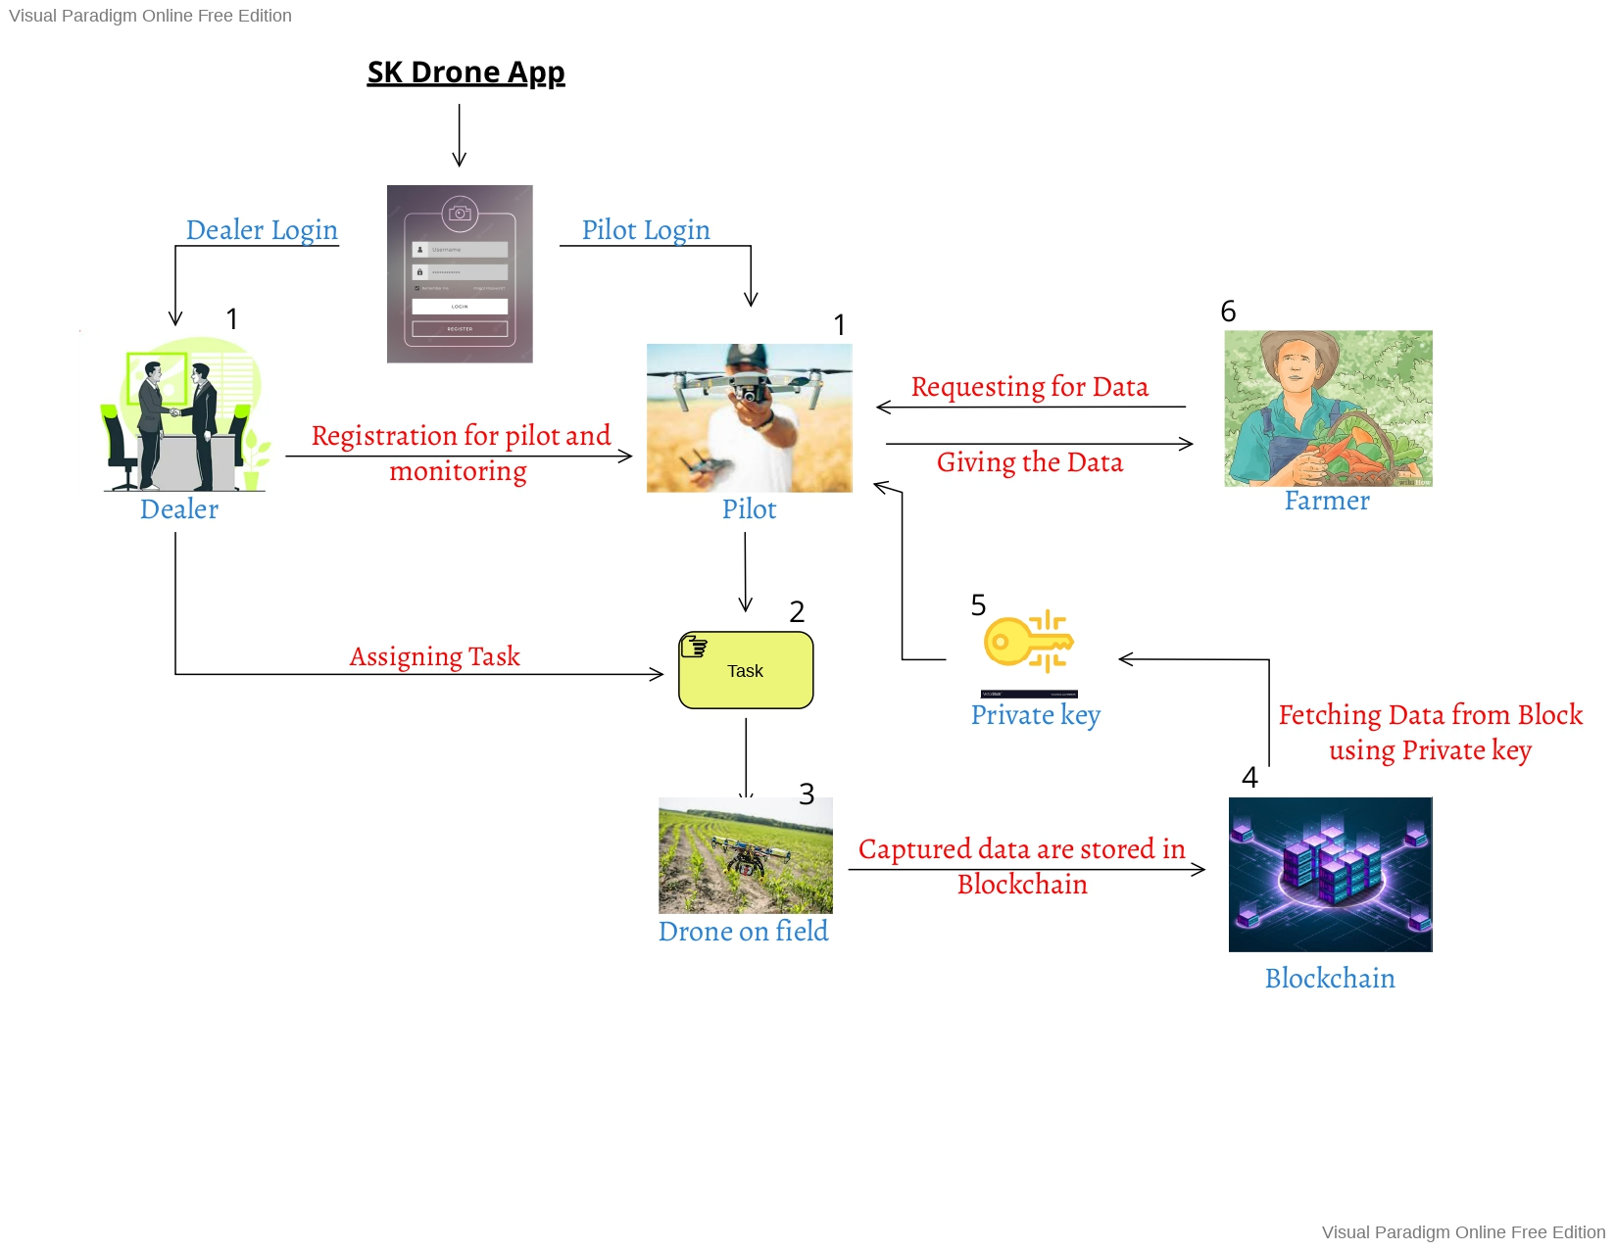
APPLICATION ARCHITECTURE

Slide 13
THANK YOU

